Slide 1




FDA Adverse Reactions Analysis
By: Chloe Schnydman and Rahma Semma

Slide 2

Background
The FDA’s FAERS (FDA Adverse Event Reporting System) database collects voluntary reports of adverse drug reactions from healthcare providers, patients, and manufacturers.
It serves as a critical resource for detecting new safety concerns, understanding drug risks, and making regulatory decisions.
Data files include information on demographics, drugs involved, reported reactions, outcomes, and drug usage patterns.

Slide 3
Purpose
The purpose of this project is to analyze adverse drug reactions reported in the FDA's FAERS (FDA Adverse Event Reporting System) database. This analysis aims to:
Identify patterns and trends in adverse reactions related to various drugs.
Determine which drugs are associated with severe or common adverse reactions.
Examine demographic factors that may influence the likelihood or severity of reported reactions.
Provide insights for healthcare professionals and regulatory agencies to improve drug safety and post-market surveillance.

Slide 4
Data Retrieval
Originally, we found this data from the National Bureau of Economic Research (NBER).
Met with professor to discuss our dataset and how to analyze it
He said that we should not use second-hand data, and he helped us find the FDA’s REAL data
The official dataset we are working with is FDA Adverse Event Reporting System (FAERS): Latest Quarterly Data Files. It includes:
Demographic and administrative information and the initial report image ID number (Demo)
Drug information from the case reports (Drug)
Reaction information from the reports (Reac)
Patient outcome information from the reports (Outc)
Information on the source of the reports (Rpsr)
Drug therapy start dates and end dates from the reports (Ther)
Found two versions of the data: JSON and ASCII

Slide 5
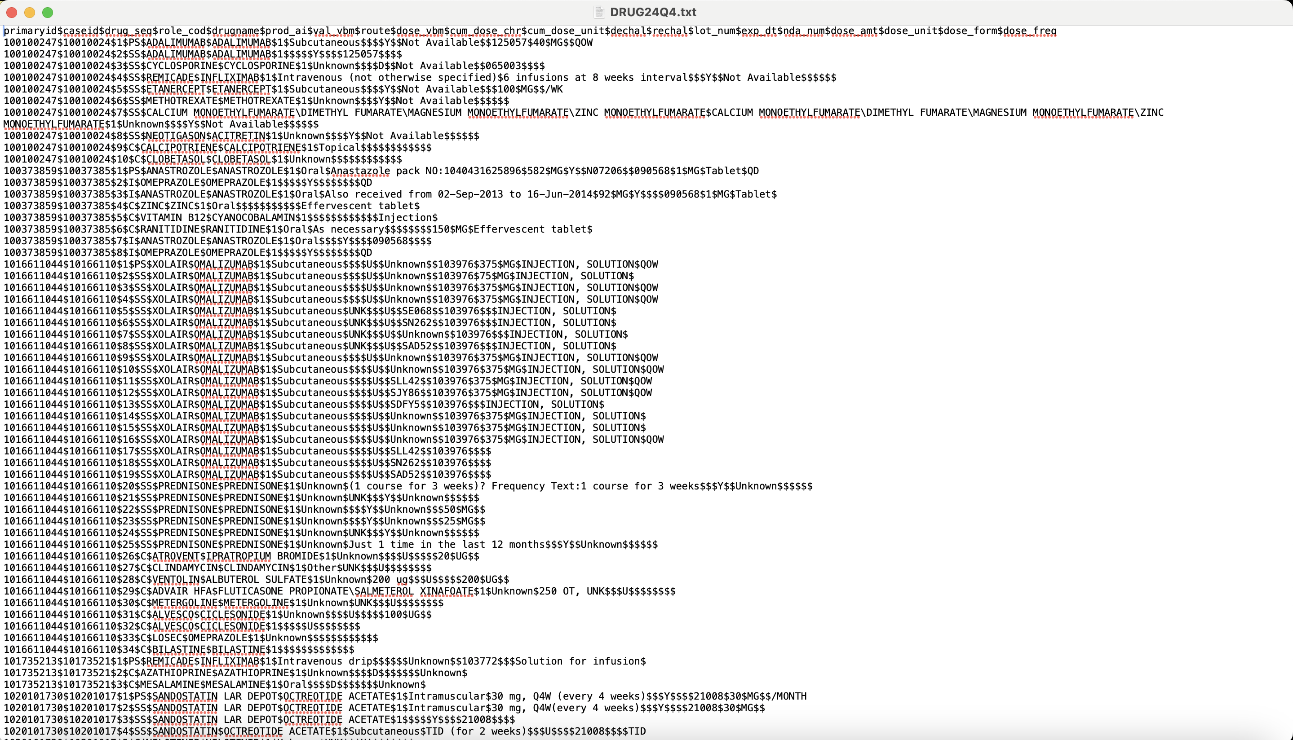
ASCII Data Before Converting

Slide 6
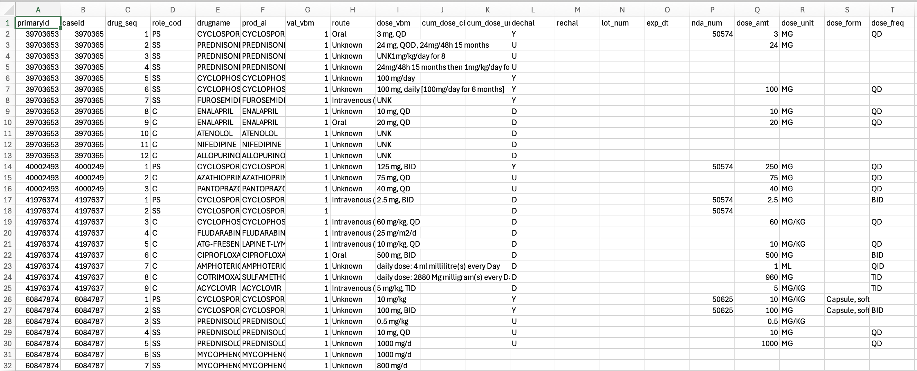
Data After Converting
Drug Dataset

Slide 7
Some questions asked while looking through the data:
Why was this number repeated so many times?
Why are these columns basically the same?
What’s the difference between primaryid and caseid?
Drug Dataset

Slide 8
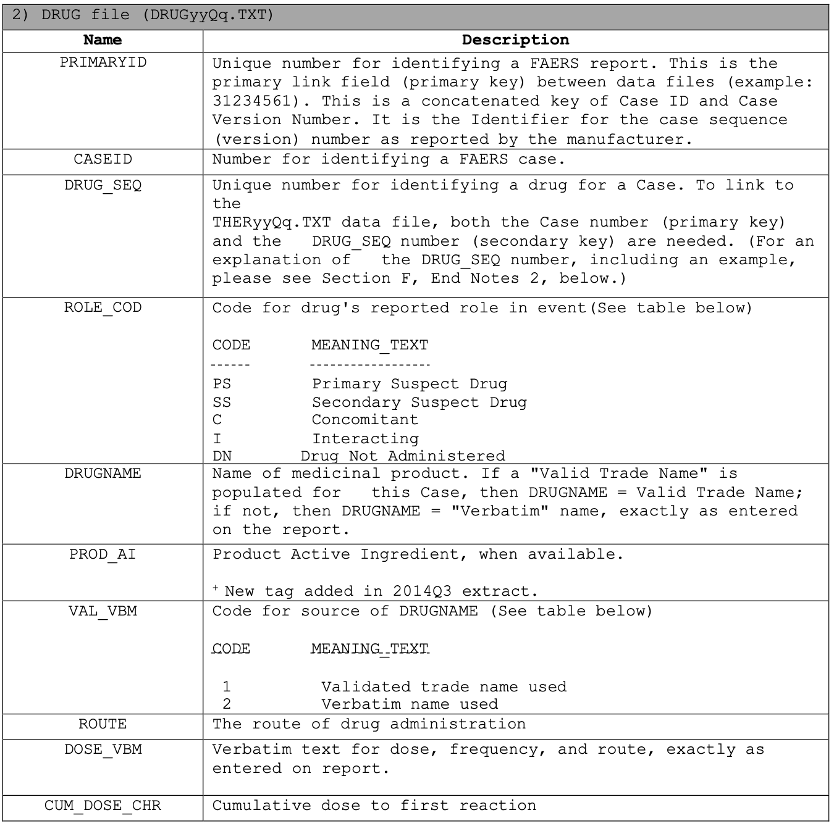
Codebook
This is just a small portion of the codebook for the Drug Dataset

Slide 9
Right now…
We are actively:
going through all 7 datasets and deciding which ones we think are necessary to include in our analysis
cleaning the datasets one by one since each one has over a million values
merging the datasets (most likely) by the priamryid

Slide 10
Ethical Considerations
Informed Consent & Data Collection:
The FAERS data is collected voluntarily by healthcare providers, patients, and manufacturers.
While not obtained directly from patients, ethical research involves acknowledging the limitations of voluntarily reported data and ensuring the data is used for legitimate scientific purposes.
Bias & Limitations of Voluntary Reporting:
Selection Bias:
Reports are more likely to include serious or unusual adverse events rather than common, mild reactions.
Underreporting is a significant limitation that can skew findings.
Reporting Bias:
Reports may be influenced by media coverage, legal actions, or manufacturer promotions.
Data cleaning and analysis should account for potential biases where possible.

Slide 11

Potential Models
1. Clustering Analysis (K-Means Clustering)
Purpose: Group drugs with similar adverse reaction profiles.
Why: Simple and efficient for grouping data based on similarity.
Application: Create a drug-reaction matrix and find clusters of drugs causing similar reactions.
2. Hierarchical Clustering
Purpose: Visualize relationships between drugs and reactions.
Why: Useful for understanding how clusters merge and split.
Application: Creating a dendrogram to explore similarity hierarchies.
3. Predictive Modeling (Random Forest / Logistic Regression)
Purpose: Predict the likelihood of severe reactions.
Why: Provide a statistical basis for understanding which drugs are more likely to cause severe reactions.
Application: Classifying reactions as severe or mild based on drug type, dosage, etc.

